Slide 1
Citizen Complaint Authority Update
May 10, 2021
Woman’s City Club of Greater Cincinnati
Presented by Gabe Davis, Executive Director

Slide 2
Overview
2
Mission Statement
History: Life Before and Life Since Citizen Complaint Authority (CCA) Creation
Organizational Structure
Investigation Process
Board Review
Case Scenario
Challenges and Opportunities
Discussion and Questions

Slide 3
Mission Statement
3
The Citizen Complaint Authority’s (CCA) mission is to investigate serious interventions by police officers, including, but not limited to discharging of firearms, deaths in custody, and major uses of force, and to review and resolve all citizen complaints in a fair and efficient manner.
At a minimum, CCA has jurisdiction over complaints alleging excessive use of force; improper pointing of firearms; improper stops; improper entries, searches and seizures; and discrimination, including racial profiling.

Slide 4
4
CCA Ultimate Goals
Address citizens’ concerns, improve citizens’ perceptions of quality police service in the City of Cincinnati
Improve the delivery of those services

Slide 5
5
History
Cincinnati Civil Disorders of 2001
Civil unrest occurred in and around the Over-the-Rhine neighborhood from April 9 to 13, 2001. This was the largest urban disturbance in the United States since the 1992 Los Angeles riots.
Sparked after 19-year-old Timothy Thomas, an unarmed black male, was shot and killed by a Cincinnati Police Officer during an attempt to arrest him for non-violent misdemeanors, mostly traffic citations.

Slide 6
6
History
Change Did Not Come Easily
In the 6 years before the riots, 15 black men died during confrontation or while in custody while no white suspects were killed in that period.
Three weeks before the riots, the American Civil Liberties Union (ACLU) and a group of local organizations filed a lawsuit against the Cincinnati Police Department (CPD) and City, alleging 30 years of racial profiling.

Slide 7
7
History
New Policing Strategy Adopted
The lawsuit led to the Collaborative Agreement (CA), which required CPD to adopt community-oriented policing.
A Memorandum of Agreement (MOA) between the U.S. Department of Justice (DOJ), the City and the CPD was executed, creating initiatives to improve policing in Cincinnati.
U.S. District Judge Susan Dlott appointed a federal monitor who oversaw compliance for the next 6 years.
Notes:
Use of force guidelines. Guidelines for investigations of citizen complaints.

Slide 8
8
History
The CA, enacted in April 2002, outlined the following objectives:
Establish mutual accountability and responsibility for evaluation of community problem solving implementation.
Use of force complaint process and compliance with the MOA.
Collaboration to ensure fair, equitable and courteous treatment for all.
Build relationships of respect, cooperation and trust within and between police and communities.

Slide 9
9
History
The CA, enacted in April 2002, outlined the following objectives:
Improve education, oversight, monitoring, hiring practices and accountability within CPD.
Create methods to enhance the public’s understanding of CPD policies and procedures and to recognize exceptional service in an effort to foster support for CPD.
Create CCA.

Slide 10
10
History
CCA Created
Key outcomes from the Collaborative and Memorandum Agreements in 2002 (Ordinance # 0108-2002, codified in the Cincinnati Administrative Code, Article XXVIII) were:
CCA was established as an independent and impartial forum for the review, investigation and resolution of misconduct complaints filed by citizens against police officers.
CCA was created with investigative and administrative authority.

Slide 11
11
Organizational Structure
Director, Investigators and Administrative Professionals
Advisory Board: Up to 7 citizens appointed by Mayor, approved by City Council
Current Voting Board Members:
Mark (Zeek) Childers, Chair
George Pye, Vice Chair
Tim Barr, Jr.
Tracey Johnson
Luz Elena Schemmel
Phyllis Slusher
Wanda Spivey

Slide 12
12
City Manager
Paula Boggs Muething
CCA Director
Gabriel Davis
Chief Investigator
Dena Brown
Investigator
Jonathan Batista
Senior Administrative Specialist
Michelle Bonner
CCA Board
Administrative Specialist
Heidi Woods
Investigator
Jessalyn Goodman
Investigator
Ike Ekeke
Investigator
Morgan Givens

Slide 13
COMPLAINT AND INVESTIGATION PROCESS
13

Slide 14
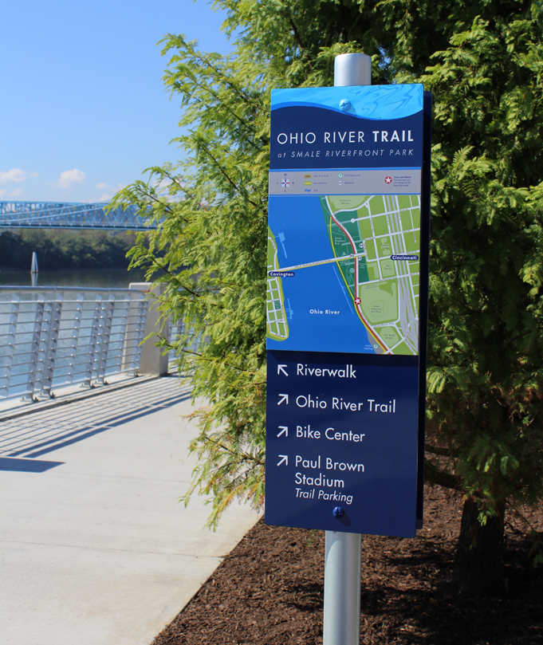
14
Complaint and Investigation Process
Summary of Steps:
Intake
Complaint is filed
Investigation
Review, Analysis and Determination
CCA Findings & Recommendations
Board Review
City Manager’s Final Decision
Final Decision Sent to Chief of Police

Slide 15
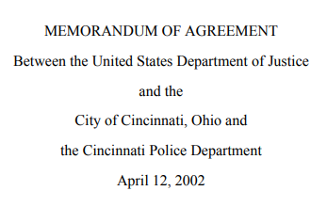
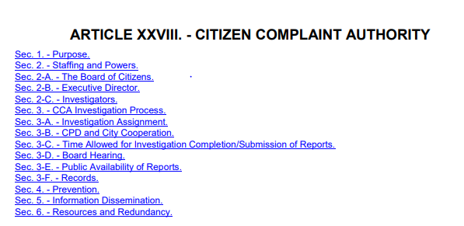
15
CCA Investigations
Collaborative Agreement/Article XXVIII, Section 3
Memorandum of Agreement, Section 6 (paragraphs 35-56)

Slide 16
16
What complaints does CCA investigate?
$14.4
$14.6
Complaints Investigated by CCA
Discrimination/Racial Profiling
Improper Entry, Search and Seizure
Excessive Use of Force
Improper Stop
Improper Pointing of Firearm
Discharge of Firearm
Death in custody
Secondary Causes of Action Investigated by CCA
Discourtesy or Unprofessional Attitude
Lack of Proper Service
Improper Procedure
Harassment
Abuse of Authority
$11.4
$11.1
$9.0
$8.5

Slide 17
17
CCA Investigations
Utilize an investigative protocol:
Review the allegations
Gather, review and analyze evidence
Interview all parties involved and witnesses
Interpret all applicable laws, regulations, policies, procedures, decisions, standard practices and training
Analyze information, using the preponderance of evidence burden of proof
Provide final analysis, conclusion and disposition
Recommend action (when necessary)
City
CAP Rehab
Carry-Over Grants
Grants

Slide 18
18
CCA Investigations
CCA’s findings will be one of the following (consistent with MOA):
Unfounded - where the investigation determined no facts to support that the incident complained of actually occurred;
Sustained - where the person's allegation is supported by sufficient evidence to determine that the incident occurred, and the actions of the officer were improper;
Not Sustained - where there are insufficient facts to decide whether the alleged misconduct occurred; or
Exonerated - where a preponderance of the evidence shows that the alleged conduct did occur but did not violate CPD policies, procedures, or training.

Slide 19
19
CCA Investigations
Administrative investigations
Burden of proof = preponderance of evidence Does 51% of the evidence favor one side or the other?
90 days – Investigation completed, unless extenuating circumstances

Slide 20
20
CCA Investigations & Board Review
Once the investigation is completed and finalized:
Director makes finding(s) and forwards the investigative report to the Board. Report may include recommendations and observations.
Board meets in open public forum each month.
Board confirms the completeness of the CCA investigation and approves or disapproves CCA’s findings and recommendations; Board shall not re-investigate the case.

Slide 21
21
CCA Investigations & Board Review
Once the investigation is completed and finalized (continued):
Board may agree or disagree, in whole or in part, and issue its own recommendations.
Pursuant to the Director’s recommendation (if necessary): Board authorized to issue subpoenas, require City Council approval.
Report is forwarded to the City Manager, who agrees or disagrees, in whole or in part. City Manager’s decision is FINAL.

Slide 22
Case Scenario
22

Slide 23
23
Case Scenario
Complaint # | 18185
Complainant | Julia Jeffries
CCA Investigator | Dena Brown
CCA Findings | Complainant Marcella Juergens Sergeant Nathan Asbury Entry (Residence) - NOT SUSTAINED Officers Marc Schildmeyer and Deon Mack, Sergeant Nathan Asbury Procedure (Consent to Search) – SUSTAINED Officer Marc Schildmeyer Improper Search (Residence) - SUSTAINED Officers Deon Mack and Cian McGrath, Sergeant Nathan Asbury Improper Search (Residence) - NOT SUSTAINED Officers Cian McGrath, Deon Mack and Marc Schildmeyer Procedure (BWC – Turned off Early) – SUSTAINED

Slide 24
24
Case Scenario
Complaint
On September 14, 2018, Ms. Julia Jeffries alleged that Cincinnati Police Officers stopped her son in a vehicle and took him into custody at gunpoint . . . Further, Ms. Jeffries alleged that police officers improperly entered and searched the residence of her mother, Ms. Marcella Juergens.

Slide 25
25
Case Scenario
Analysis
Police obtained written consent for the officers to conduct a search . . . .
However, CPD training provides that a consent search should be limited to only those places and things that the person expressly or impliedly authorized to be searched. . . .
BWC footage showed that, prior to signing the form, Ms. Juergens indicated her belief that the officers only intended to search Mr. Jeffries’s bedroom. When she attempted to clarify this point with” the lead officer, that officer “responded, ‘Just his room, because he told us,’ and then [that officer] added that they would ‘search his room and anything out in the open’ that may harm Ms. Juergens or the officers. Only then did Ms. Juergens sign the Consent to Search Form.

Slide 26
26
Case Scenario
Analysis
Rather than limit the search of the residence to Mr. Jeffries’s bedroom and to anything out in the open as [the officer] stated, police proceeded to search the entire residence, going inside of drawers and cabinets.
Several BWCs were turned off too early, and before the completion of the search.
Notes:
From Report:
“Accordingly, the evidence indicates that Ms. Juergens agreed to the search with the understanding that the officers planned to search only Mr. Jeffries’s bedroom and areas out in the open for items in plain view, and that her limits were ignored. Therefore, because the search of the residence went beyond the scope of the consent given . . . CCA determined the officers’ search of the residence was not within CPD’s policy, procedure, and training.”

Slide 27
27
Challenges
Investigation backlog
Limited capacity to fulfill non-investigatory duties
Patterns Analysis
Mediation
Community Engagement
Funding
Notes:
How can WCC help:
-Like and follow on social media
-Share social media
-Join Ambassador’s Program
-Advocate for us in community with those in leadership
-Attend board meetings

Slide 28
Questions?
28
Citizen Complaint Authority
805 Central Avenue, Suite 222
Cincinnati, OH 45202
Telephone: 513.352.1600
Facsimile: 513.352.3158
Website: www.cincinnati-oh.gov/ccia/
Email: CCA@cincinnati-oh.gov

Slide 29
BONUS: Statistics
29

Slide 30
30
Assigned Citizen Complaints
CCA Case Totals |  | IIS/CCRP Case Totals
2020 75 |  | 2020 174
2019 84 |  | 2019 200
2018 77 |  | 2018 164
2017 65 |  | 2017 177
2016 85 |  | 2016 168
Notes:
Total of 249 complaints reviewed by CCA in 2020.
Withdrawn complaints are in addition to CCA or IIS/CCRP totals.
IIS/CCRP Case Totals for previous years include CCA NJ
Withdrawn:
2019 – 285 including 1 Withdrawn
2018 – 243 including 2 Withdrawn
2017 – 244 including 2 Withdrawn
2016 – 253 including 0 Withdrawn
2015 – 286 including 16 Withdrawn

Slide 31
31
Five-Year Complaint Trend

Slide 32
32
Five-Year Allegations
Allegations | 2016 | 2017 | 2018 | 2019 | 2020
Criminal | 0 | 0 | 1 | 0 | 0
Death (TASER) | 1 | 0 | 0 | 0 | 0
Death in Custody | 0 | 10 | 7 | 0 | 1
Detention | 4 | 1 | 2 | 7 | 6
Discharge of Firearm | 9 | 3 | 12 | 3 | 4
Discourtesy | 33 | 18 | 9 | 39 | 35
Discrimination | 16 | 8 | 16 | 15 | 26
Frisk | 0 | 0 | 0 | 0 | 0
Harassment | 8 | 7 | 9 | 18 | 13
Lack of Service | 1 | 10 | 13 | 16 | 9
Law Violation | 0 | 0 | 0 | 0 | 1
Pointing of a Firearm | 17 | 12 | 9 | 10 | 19
Procedure | 27 | 15 | 6 | 28 | 19
Racial Profiling | 0 | 4 | 0 | 6 | 0
Search/Seizure/Entry | 86 | 49 | 45 | 42 | 79
Sexual Misconduct | 2 | 0 | 0 | 2 | 0
Stop | 26 | 26 | 26 | 44 | 33
Unethical Conduct/Misconduct | 0 | 0 | 0 | 9 | 1
Use of Force/Excessive Force | 73 | 56 | 54 | 83 | 65
Total | 301 | 219 | 209 | 322 | 311
Notes:
Top 5 Allegations assigned to complaints investigated by CCA in 2020
Use of Force /Excessive Force
Search/Seizure/Entry
Discourtesy
Stop
5) Discrimination

Slide 33
33
Five-Year CCA Complaint and Allegation Trend

Slide 34
34
Five-Year CCA Finding Trend

Slide 35
35
2020 Complaints by CPD District

Slide 36
36
Neighborhoods with Most Complaints
Rank | 2016 | 2017 | 2018 | 2019 | 2020
1 | Westwood | Avondale | Westwood | Westwood | Westwood
2 | Avondale | CBS | CBS | OTR | OTR
3 | OTR | OTR | OTR | CBS | Avondale
4 | West End | Westwood | Avondale | West End | College Hill
5 | CBS | Price Hill | West End | Avondale | West End

Slide 37
37
Complainant Demographics

Slide 38
38
Officer Demographics

Slide 39
39
Officer Demographics

Slide 40
40
Patterns Report
The patterns criteria represented includes:
Repeat officers: Officers with complaints from 10 or more complainants in past 3 years.
2018 – 2 officers
2019 – 3 officers
2020 – 2 officers
Repeat citizens: Citizens who filed more than 3 complaints in past 3 years.
2018 – 9 complainants
2019 – 4 complainants
2020 – 6 complainants

Slide 41
41
Patterns Report
The circumstance of each complaint is also tracked in the Annual Patterns Report. The top five repeat circumstances in 2020 were:
Request for Service (96)
Accident (24)
Communication (18)
Traffic Stop (16)
General Investigation (15)

Slide 42
42
Annual Report
CCA produces a full detailed report annually, summarizing activities for the previous year as well as noting any trends or patterns. The report is public and available via CCA’s website.
The Annual Report creates dialogue about potential changes, but also, allows the CPD and the CCA to review the past year to see how the recommendations/ observations made and the priorities noted affected change throughout the previous year.
CCA Annual Reports can be found at: cincinnati-oh.gov/ccia /citizen-complaint-annual-reports

